Slide 1


GloboDiet interview: recipes
INTERNATIONAL AGENCY FOR RESEARCH ON CANCER LYON - FRANCE
e-SMP

Slide 2

GloboDiet: Overall internal structure
Composed Recipes
Mixed recipes
Ingredients, treated like foods
Recipe Classification
Description and quantification (D/Q)
Recipes
IARC, Lyon - France
GloboDiet training:

Slide 3


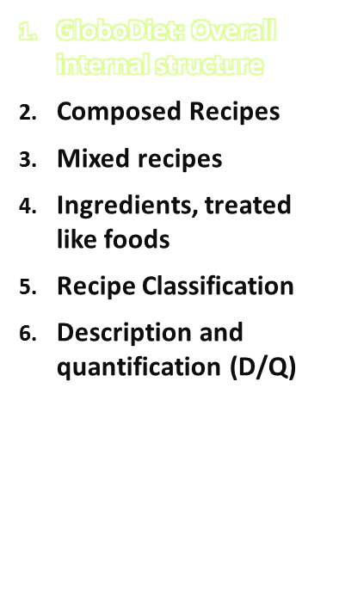
Selected Quick List Item
Food Pathway
Mixed Recipe
Pathway
Automatic search
Found in the food list ?
Found in the recipe list ?
Yes
No
Two main pathways
  Food pathway
  Recipe pathway
The same sequence of events during the interview (search, description, quantification, probe)
Describe
food
Describe
food
Quantify
food
Quantify
food
Probing
questions
Probing
questions
Notes
Overall internal structure
IARC, Lyon - France
GloboDiet training:

Slide 4
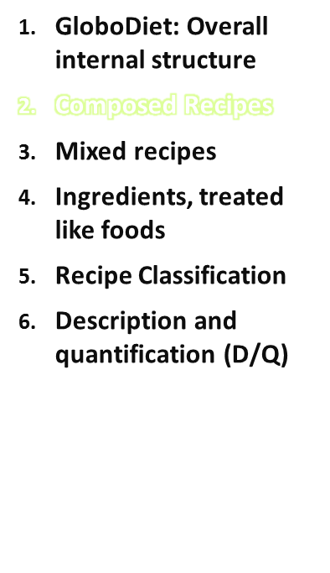
Definition: its different ingredients can be identified and quantified separately after preparation (e.g. meat balls in sauce, rice with sauce, couscous dish, mixed salad) or just before mixing (e.g. coffee with milk).
Composed recipes are built during the interview: there is no a priori list of composed recipes. They are made from items listed below/linked to a quick list item.
Recipes
IARC, Lyon - France
GloboDiet training:

Slide 5
Composed recipes
Examples:
Coffee with milk
  Coffee
  Milk
  Sugar
Meat in sauce with rice
  Beef stew (is a recipe)
  Rice
Salad
  Lettuce
  Tomato
  Cucumber
  Salad dressing (can be a recipe in some projects where all sauces are in recipes)
GloboDiet training:
IARC, Lyon - France
Recipes

Slide 6
Composed recipes
A composed recipe should be used even when some ingredients such as fat, sauce or sweetener cannot be quantified: standard percentages (PCTFSS) are in GloboDiet to avoid missing values
There is the possibility to have standard portions (e.g. for cheese or tuna) to be used to compose a mixed salad for example
→ to be planned when preparing local data (FDSTD)
GloboDiet training:
IARC, Lyon - France
Recipes

Slide 7
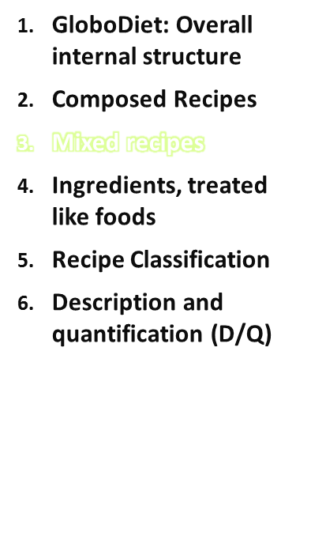
In the recipe list: there are several types of mixed recipes:
  OPEN: may be homemade or not.
  If homemade, may be known or not.
  OPEN WITH BRAND
  CLOSED: may be homemade or not
  CLOSED WITH BRAND
  STRICTLY COMMERCIAL WITH BRAND
  Substitute, Add, Delete
  Substitute
-
Stepwise binary questions
  In the food or recipe list?
  If recipe, Commercial or not?
  If homemade, Known by the subject or not?
If not found, new recipes can be created
  NEW: may be homemade or not. If homemade, may be known or not.
Substitute, Add, Delete
GloboDiet training:
IARC, Lyon - France
Recipes

Slide 8
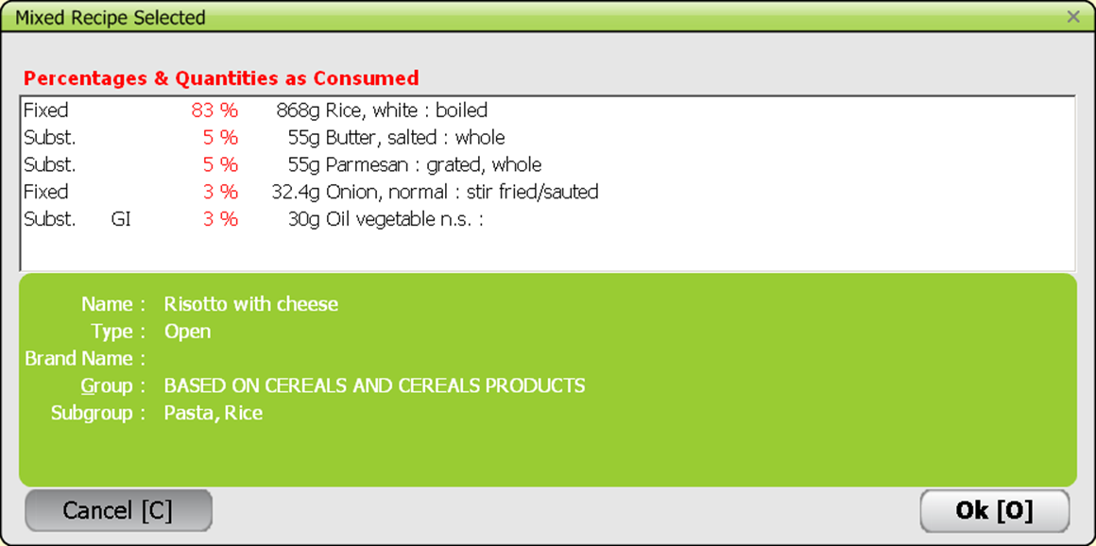
Mixed recipes
Steps in GloboDiet:
Choose the recipe in the list (or new) and quick check
GloboDiet training:
IARC, Lyon - France
Recipes

Slide 9
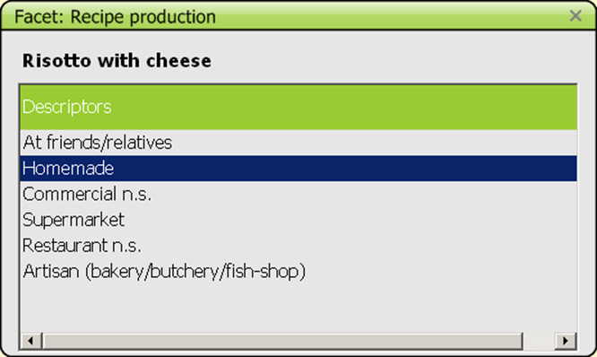
Mixed recipes
Steps in GloboDiet:
Choose the recipe in the list (or new) and quick check
Question on recipe production (facet)
GloboDiet training:
IARC, Lyon - France
Recipes

Slide 10
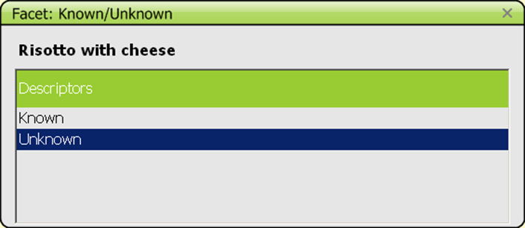
Mixed recipes
Steps in GloboDiet:
Choose the recipe in the list (or new) and quick check
Question on recipe production (facet)
If homemade: is the entire recipe known (incl. quantities)?
GloboDiet training:
IARC, Lyon - France
Recipes

Slide 11
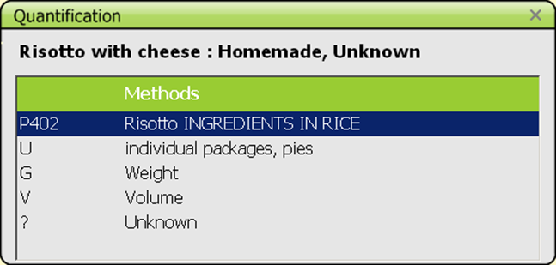
Mixed recipes
Steps in GloboDiet:
Choose the recipe in the list (or new) and quick check
Question on recipe production (facet)
If homemade: is the entire recipe known (incl. quantities)?
Further description of the recipe (facets)
Quantification of the consumed portion
GloboDiet training:
IARC, Lyon - France
Recipes

Slide 12
Mixed recipes
Steps in GloboDiet:
Choose the recipe in the list (or new) and quick check
Question on recipe production (facet)
If homemade: is the entire recipe known (incl. quantities)?
Further description of the recipe (facets)
Quantification of the consumed portion
If not ‘strictly commercial’, check the ingredients and save the recipe
GloboDiet training:
IARC, Lyon - France
Recipes

Slide 13
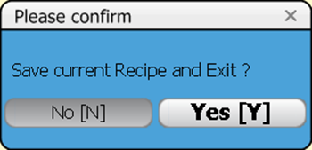
Mixed recipes
Steps in GloboDiet:
Choose the recipe in the list (or new) and quick check
Question on recipe production (facet)
If homemade: is the entire recipe known (incl. quantities)?
Further description of the recipe (facets)
Quantification of the consumed portion
If not ‘strictly commercial’, check the ingredients and save the recipe
When working on recipes, there is the possibility to
  have a ‘Help recipe’
  take notes if some actions (add/delete) are not proposed for the recipe or to provide information needed to update the recipe (e.g. eaten at restaurant X in town Y)
GloboDiet training:
IARC, Lyon - France
Recipes

Slide 14
Mixed recipes
Steps in GloboDiet:
Choose the recipe in the list (or new) and quick check
Question on recipe production (facet)
If homemade: is the entire recipe known (incl. quantities)?
Further description of the recipe (facets)
Quantification of the consumed portion
If not ‘strictly commercial’, check the ingredients and save the recipe
When working on recipes, there is the possibility to
  have a ‘Help recipe’
  take notes if some actions (add/delete) are not proposed for the recipe or to provide information needed to update the recipe (e.g. eaten at restaurant X in town Y)
GloboDiet training:
IARC, Lyon - France
Recipes

Slide 15
Practise
Enter a new interview with 2 quick items at lunch ‘recipe 1’ and ‘recipe 2’.
Choose a local strictly commercial recipe and describe it Choose a local open recipe (without brand) and describe it
  Homemade, unknown
  No change in ingredients
quantify with ‘?’
GloboDiet training:
IARC, Lyon - France
Recipes

Slide 16

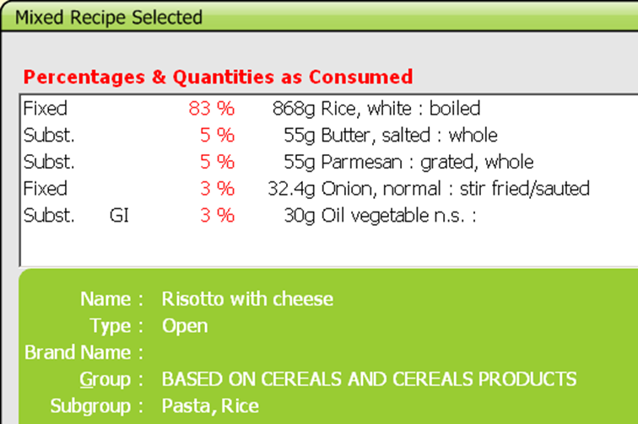
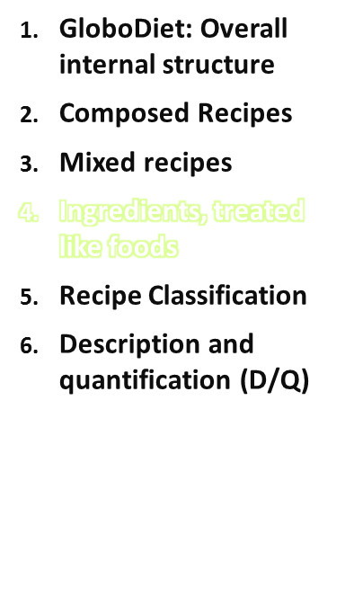
Fixed ingredients - cannot be replaced or re-described during the interview.
Substitutable ingredients - can be replaced or re-described during the interview → the recipe is more flexible
GloboDiet training:
IARC, Lyon - France
Recipes

Slide 17
Ingredients, treated like food
Fixed ingredients - cannot be replaced or re-described during the interview. This is the case when:
no replacement is expected at all (e.g. spices)
the ingredient has low nutritional impact (e.g. stock cubes)
the ingredient is not likely to vary (e.g. egg)
often, the ingredient appears in the name of the recipe
the recipe is strictly commercial (all ingredients are fixed)
Substitutable ingredients - can be replaced or re-described during the interview →recipe is more flexible (e.g. oil n.s. replaced by margarine, A.)
ingredients which are likely to be replaced within the same group/subgroup so that the recipe becomes more flexible
generic ingredients [n.s.]
all sauces, fats and dairy creams
all ingredients with at least one descriptor ‘undefined’ (descriptor 00)
ingredients attached to facets 12 Brandname, 13 Skin consumed and 14 Visible fat consumed as their descriptors are very interviewee-specific.
GloboDiet training:
IARC, Lyon - France
Recipes

Slide 18
Ingredients, treated like food
Note that:
Quantity of substitutable ingredients cannot be changed.
Physical state descriptors ‘powdered’, ‘condensed/evaporated’, ‘dried or flakes’ and ‘semi-dried’ cannot be substituted in order to avoid quantification problems.
Water used for cooking/hydrating rice, pasta, legumes is accounted for in the raw-to-cooked coefficient
For stews, we cannot count for water evaporation: the quantity of liquid remaining after cooking is entered.
Avoid entering ‘mashed’ ingredients as the type of fat and type of milk/liquid might be asked – qualitative information only:
→ choose ‘flesh’ and list fats and liquids as separate ingredients and quantify them.
GloboDiet training:
IARC, Lyon - France
Recipes

Slide 19
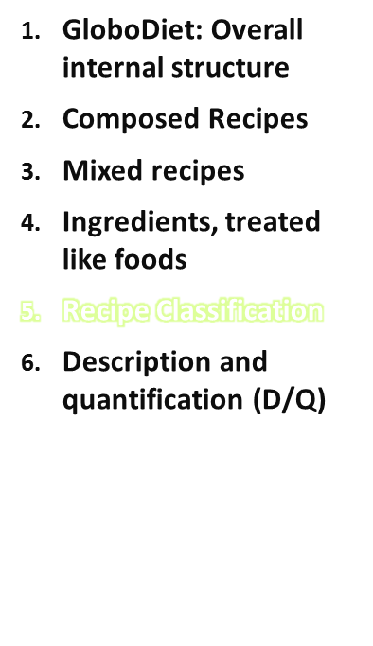
The recipe classification of GloboDiet is data-collection oriented, it might be used for searching.
Recipe groups (# sub-groups)
Based on meat and meat products (6)
Based on fish and crustaceans/molluscs (3)
Based on egg (0)
Based on cereal and cereal products (6)
Based on vegetables (incl. potatoes) (5)
Mixed beverages (0)
Soups (6)
Sweet recipes (5)
Sauces (0)
Other (0)
GloboDiet training:
IARC, Lyon - France
Recipes

Slide 20
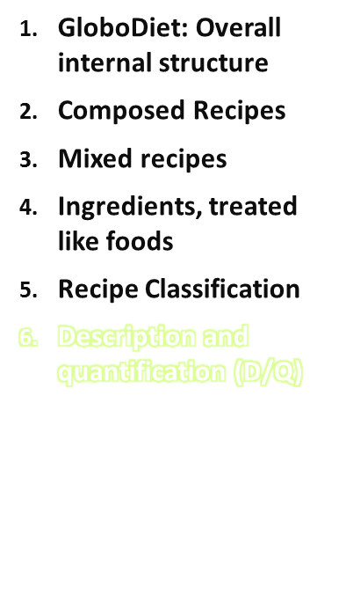
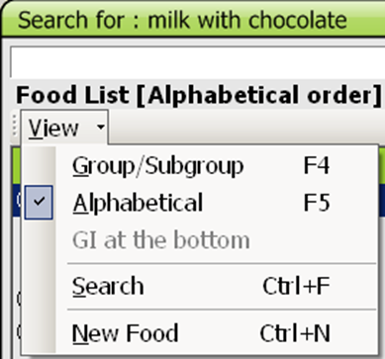
Search the item
Know how to deal with it depending on the information that the subject is able to provide
e.g. ‘milk with chocolate’ may be:
A food item: use ‘milk beverage’, describe as flavoured with chocolate, sweetened,… brand X and quantify
A composed recipe: list ‘milk’, ‘chocolate powder’, describe and quantify each
A mixed recipe: check substitutable ingredients. If OPEN recipe, ingredients may be added and deleted.
Use the alphabetical,
by group or
by string search
in either the food or recipe list.
GloboDiet training:
IARC, Lyon - France
Recipes

Slide 21
Description
All reported items (food, recipe, ingredients, dietary supplement) are described in GloboDiet
Depending on the item classification and its on-the-fly description, several facets and descriptors are proposed (FADEBYGROUP and FACETRULE).
Facets are questions to be asked to the interviewee
  Multiple choice is possible for recipe facets:
  Preservation method
Descriptors are possible answers to the facets.
GloboDiet training:
IARC, Lyon - France
Recipes

Slide 22
Description of Recipes
Same remarks for facets
  Recipe production: where it was produced
  Recipe brand: open list
  Recipe preservation method
  Recipe packaging.
Recipe reheating method: not handled like the food cooking method: no calculation involved (no coefficient). The raw-to-cooked coefficients are applied at the ingredient level depending on the ingredient cooking method → do not list cooking water for rice, pasta and legumes (otherwise counted twice)
GloboDiet training:
IARC, Lyon - France
Recipes

Slide 23
Quantification
Quantification concerns foods, recipe portions and ingredients if the recipe is known.
Only the consumed quantities must be entered if there are left-overs on the plate.
Depending on the item and its description, several quantification methods might be proposed (QMDETAIL)
Choose the one that suits the interviewee best: provide the picture number(s), show the shapes or HHM pictures to the interviewee
Check the dimensions whenever relevant (see presentation about interview steps on day 1)
For known recipes, the portion may be a fraction (e.g.1/4) of the prepared recipe
GloboDiet training:
IARC, Lyon - France
Recipes

Slide 24
Ingredient Description & Quantification
Recipes:
After the description of the recipe and the quantification of the recipe portion, several scenario may occur:
OPEN recipe known (be sure that all the ingredient quantities are known)
  Enter all the ingredients of the recipe including cooking fat,
  Describe and quantify these ingredients as prepared (for several persons),
OPEN recipe unknown
  Check the substitutable ingredients
  Ingredients may be added: describe and quantify what has been eaten in the subject portion
  Ingredients may be deleted
  N.B.: additions and deletions are readily effective only if they refer to small quantities. Else the recipes have to be checked and modified after the 24HR interview
CLOSED recipe
  Check the substitutable ingredients
STRICTLY COMMERCIAL recipe
  Nothing to do
‘Help recipe’ available, to be chosen in the recipe list
GloboDiet training:
IARC, Lyon - France
Recipes

Slide 25
Practise
Enter the consumed portion of the previously entered recipes
strictly commercial recipe – enter a note saying the interview did not eat an ingredient (allergy)
open recipe
  Substitute an ingredient
  Add an ingredient
  Delete an ingredient
  Save the recipe
See the difference between the content of the ingredient manager and of the description/quantification screens
GloboDiet training:
IARC, Lyon - France
Recipes

Slide 26
Summary
Steps
  Identify
  Describe
  Quantify
  Check of substitutable ingredients (if Open or Closed recipe)
  Probing
Possibility to enter New recipe
Help recipe
GloboDiet training:
IARC, Lyon - France
Recipes

